Slide 1
Overview
Application Lifecycle Management (ALM)
The continuous process of managing the life of an application through governance, development and maintenance. In addition, ALM involves various phases throughout the implementation cycle where many different participants form many different backgrounds (i.e. IT, project managers, consultants, etc.) will be involved in managing various ALM features.
Azure DevOps Services (Formerly VSTS)
Azure DevOps Services is a cloud service for collaborating on code development. It provides an integrated set of features that you access through your web browser or IDE client. Azure DevOps is the backbone tool to control and protect new and existing objects to Azure DevOps. Through collaboration in this portal, functional and technical teams can facilitate efficient task assignment and completion.
Prerequisites and Tools
Prerequisites for members of the functional group in ALM;
Must be added to the appropriate Active Directory (AD) group
Must be added to the ALM appropriate group
Link to ALM Portal Workspace
Tools
Internet Explorer (IE) version 9,10 or 11
Chrome version - latest

Slide 2
Key Terminology
Project
Task
Created to represent a fundamental container of where data is stored when added to Azure DevOps. Provides a central repository for source code and offers a place for people to plan, track progress and collaborate on building software solutions
A packaged script or procedure which includes a set of inputs for a build or release. A build or release deployment will include many tasks, which run in a particular sequence.
Bug
Work Items
Used to track different types of work. Also assigned a specific type (Work item type). Different Work item types are available depending on the process being used (Agile, Scrum or CMMI).
Used to capture and record software issues or defects in code. Ability to prioritize, assign and track progress of recorded bugs.
Impediment
Backlog
A work item type which represents unplanned activities. Used to track items that may cause problems with delivering one or more requirements.
Consists of a list of work items and serves as a central repository for information that needs to be tracked and shared with the team. Backlog items can be prioritized, assigned to team members and also used to track dependencies. Backlog often corresponds to the project plan.

Slide 3



Azure DevOps Key Features, Concepts
Source/Version Control
Allows developers to collaborate on code and track changes. Provides consistency and organization to the code management process
Tools and features within Azure DevOps provide ways to easily share and track information related to software development projects
Utilize one, several or all of the available tools throughout the lifecycle of a software development/implementation project
Work Tracking Tools
Plan and track the status of various work items. Allows team members and managers to easily view and prioritize work items. Also referred to as Azure Boards.
DevOps Tools
Tools which support the build, test and release of software. Automation tools available to further enhance these processes.

Slide 4
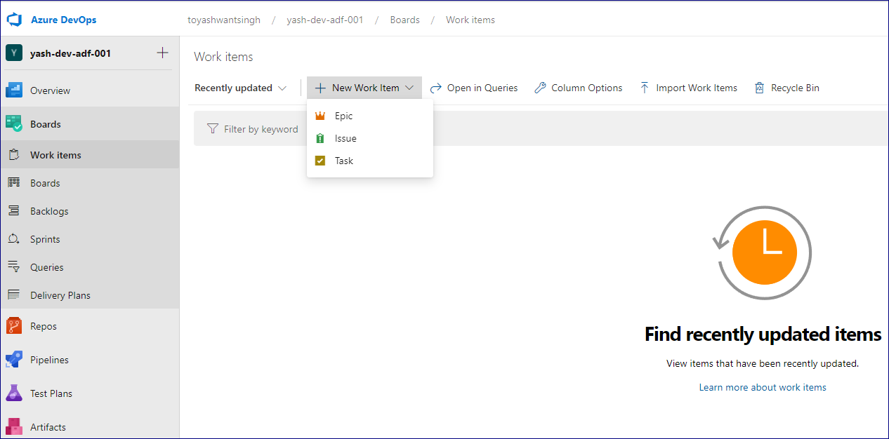
*Agile process example
Azure DevOps Agile Work Items
Epic: Used with Portfolio backlogs in order to further organize and group related items. Can quickly add and group items into a hierarchy.
Feature: Used with Portfolio backlogs in order to further organize and group related items. Can quickly add and group items into a hierarchy.
Issue: Used to track known issues or unplanned activities (referred to as Impediments in the Scrum process).
Task: Captures the work that needs to be accomplished (can be used if a team manages their work in sprints)
Test Case: Checks that each of the deliverables meet the Users’ needs. Can assign testers and test steps.
User Story: Defines the applications, requirements and elements that teams need to create
Epic
Feature
Feature
Recall: Depending on the process chosen for the project, the types of Work items will differ
User story
User story
User story

Slide 5
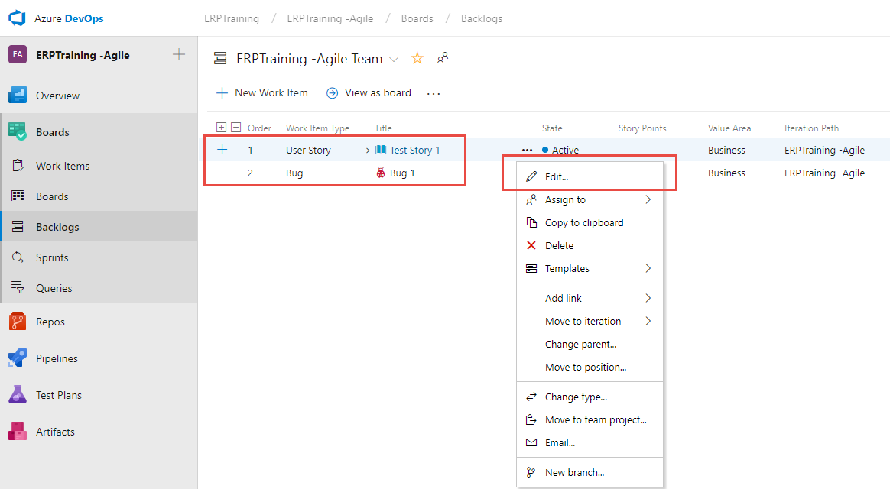
Azure DevOps - Work Item Features Bulk modify, Bulk add Excel
Bulk Modify: Quickly make the same change to several work items (change priority, reassign tasks, etc.)
01
02
03
Ability to select several items (Shift or Ctrl key options)
Can then Bulk Modify the selected items
Can drag selected items to a new position within the backlog
Product backlog
Portfolio backlog
Sprint backlog
Azure DevOps Types of Backlogs
Contains a prioritized list of user stories, deliverables, or work that needs to be built or fixed
Contain just the items that each team is working on during a scheduled sprint or iteration period
Typically track high-level features, scenarios or epics
Assist in organizing the product backlog into a hierarchy of elements
Bulk Add: Available through Excel
Add work items in bulk
Update fields with different values

Slide 6
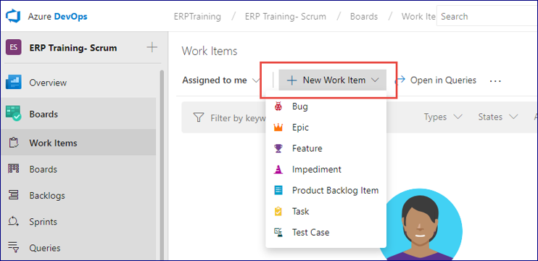
Azure DevOps Scrum Work Items
Epic: Used with Portfolio backlogs in order to further organize and group related items. Can quickly add and group items into a hierarchy.
Feature: Used with Portfolio backlogs in order to further organize and group related items. Can quickly add and group items into a hierarchy.
Impediment: Used to track known issues or unplanned activities (referred to as Issues in the Agile process).
Product Backlog Item: Defines a unit of work or requirement needed to be completed by a team within a Sprint. Often includes one or more tasks.
Task: Captures the work that needs to be accomplished (can be used if a team manages their work in sprints)
Test Case: Checks that each of the deliverables meet the Users’ needs. Can assign testers and test steps.
*Scrum process example
Recall: Depending on the process chosen for the project, the types of Work items will differ

Slide 7
What is the Process?
Start
Test
Yay or Nay
A system is ready to be tested before being deployed.
Test specific scenarios from the business process using a test script.
If the scenario passes, YAY!
If the scenario fails, a new ‘Bug’ will be created in Azure DevOps to track errors until they are wins.

Slide 8
Six Ingredients of Success
Development Finished
Follow Test Scripts
A new/existing testing task is assigned.
The goal is to have the tested business process scenario pass or be identified to fix
Login to Azure DevOps Instance
Testing Successful?
In Azure DevOps, find the product backlog and mark the Testing task ‘DONE and update the ‘Remaining Work’ field to zero
Create New Testing Task
Testing Unsuccessful?
If not already created, a new testing task must be created in Azure DevOps
Define if the issue is data or code related
If the issues is code related, create a new ‘Bug’ backlog item and assign it to a developer

Slide 9
Azure Test Plans Test and Feedback
Browser extension
Available to use with testing functionality
Browser compatibility
Available to use with Chrome, Firefox and soon to be Edge

Slide 10
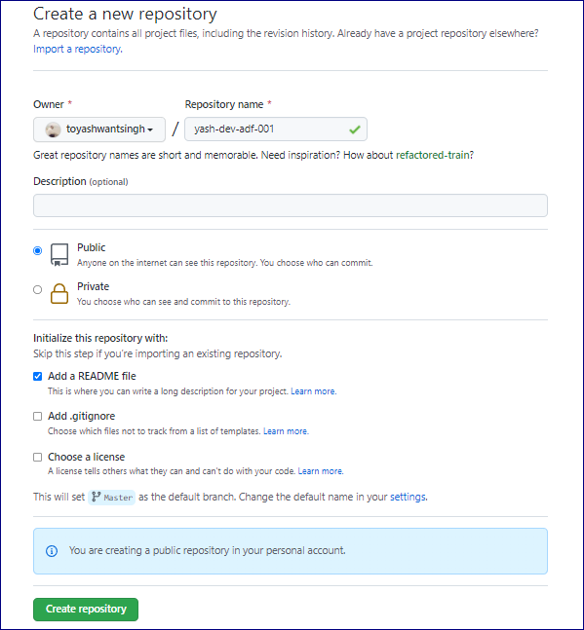
Create a GitHub Repository
After the GitHub account has been created from the pre-requisites section, a new Git repository will also need to be created.
To get stared, navigate to Repositories in the newly created GitHub account, and click New.
Next enter the new Repository name, select a Visibility option Public vs. Private, enable 'initialize this repository with a Readme', and click Create Repository.
1
2
3
4

Slide 11
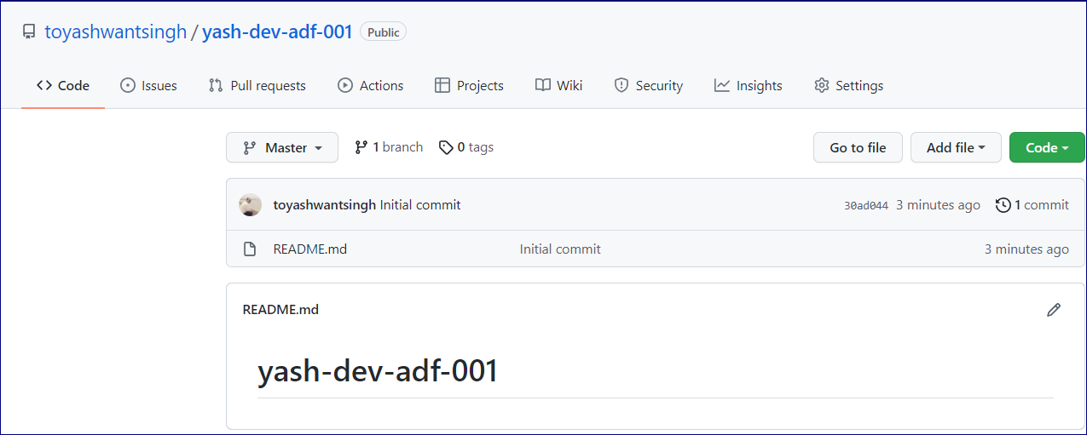
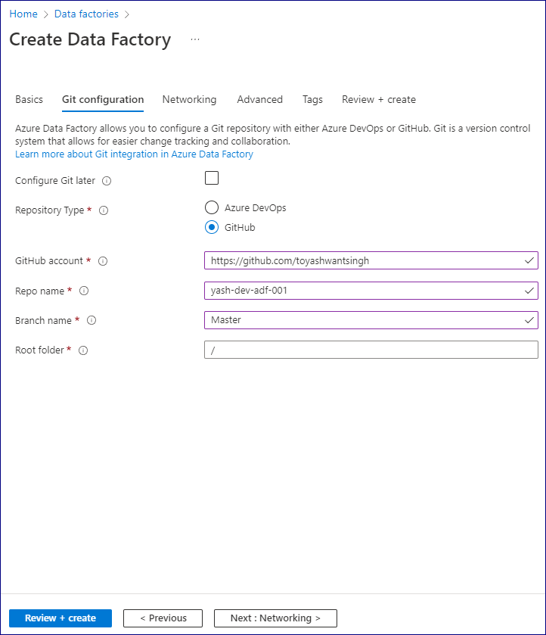
Create a GitHub Repository
Once the repository has been created, the Readme file will be viewable, and the master branch will be associated with the repo.
Create a Data Factory
While creating the new Data Factory from the pre-requisites section, ensure that GIT is Enabled.
Enter the necessary details related to the GIT account and Repo.
Click Create to provision the DEV Data Factory.
1
2
3
4
6

Slide 12
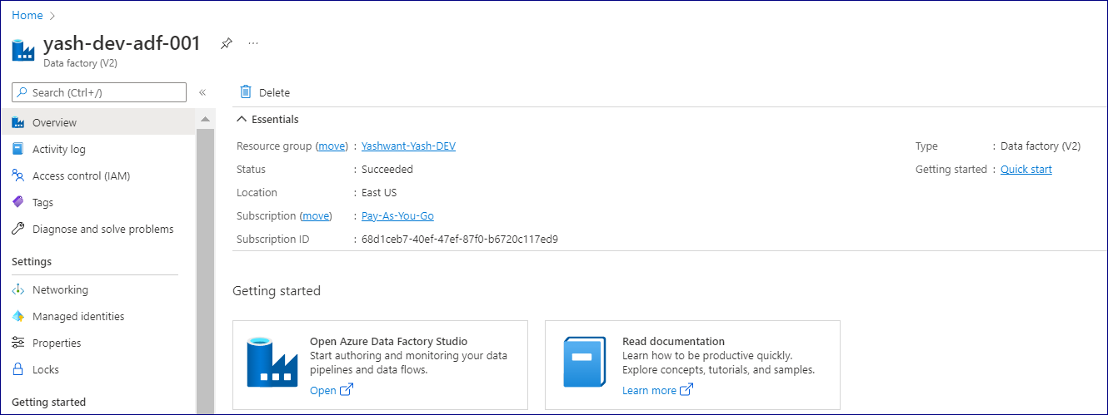
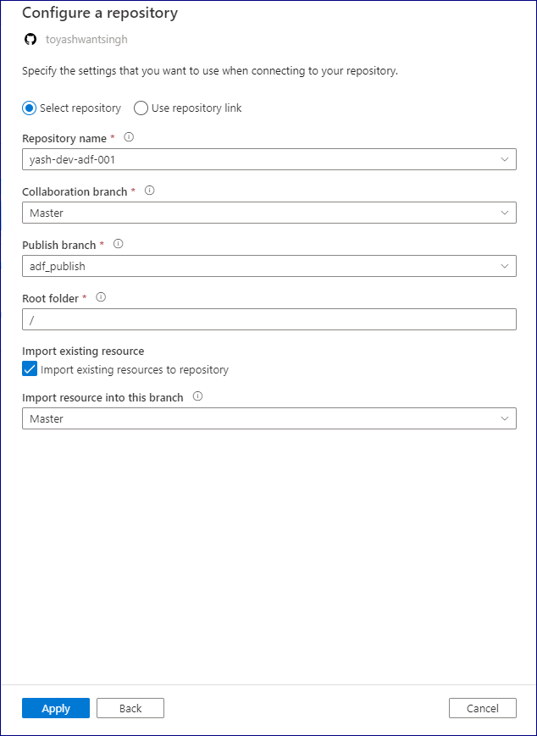
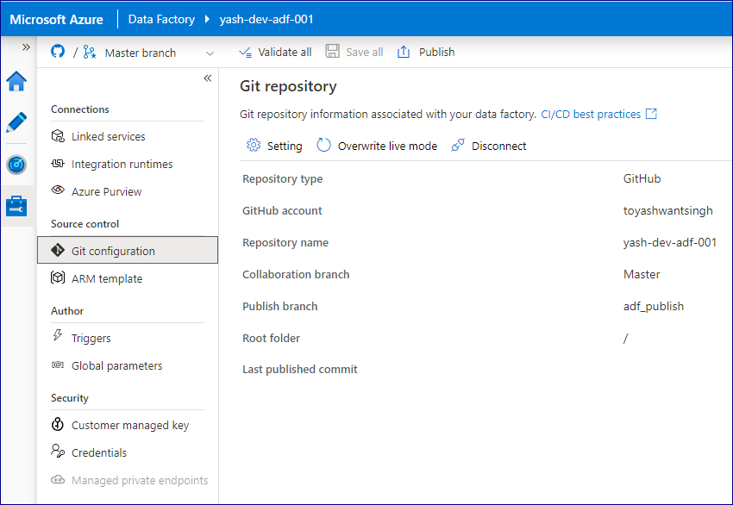
Navigate to the newly created DEV Data Factory in the desired resource group.
Click Open Azure Data Factory Studio to launch the Data Factory authoring UI.
Log into GitHub from Data Factory
When the DEV Data Factory is launched, click Log into GitHub to connect to the GitHub Account.
Next, Click the Git repo settings. Next click the Git configuration section of the connections to either Edit, Disconnect, or Verify the Git repository. We can verify Git repo connection details from this tab.

Slide 13

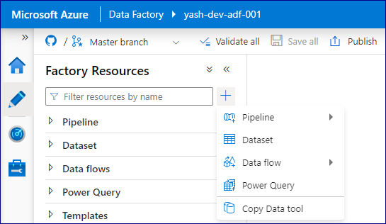
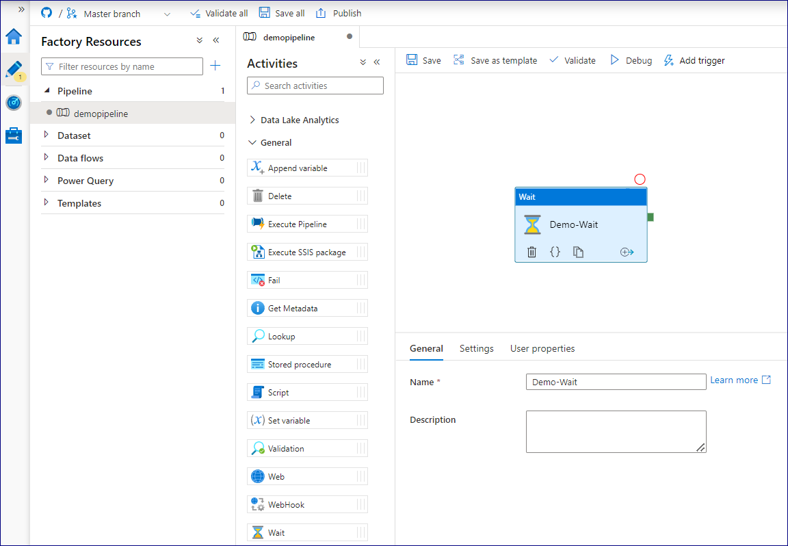
Finally, we can also see that the GitHub master branch has been selected in the top left corner of the Data Factory UI.
Create a Dev Data Factory Pipeline
Now the Data Factory has been connected to the GitHub Repo, let's create a Dev pipeline.
To create a pipeline, click the pencil icon, next click the plus icon, and finally click Pipeline from the list of options.
1
2
3
Select an activity from the list of options. To keep this demo simple, I have selected a Wait activity.
Click save and publish to check in the pipeline to the Master GitHub branch.
2
1

Slide 14
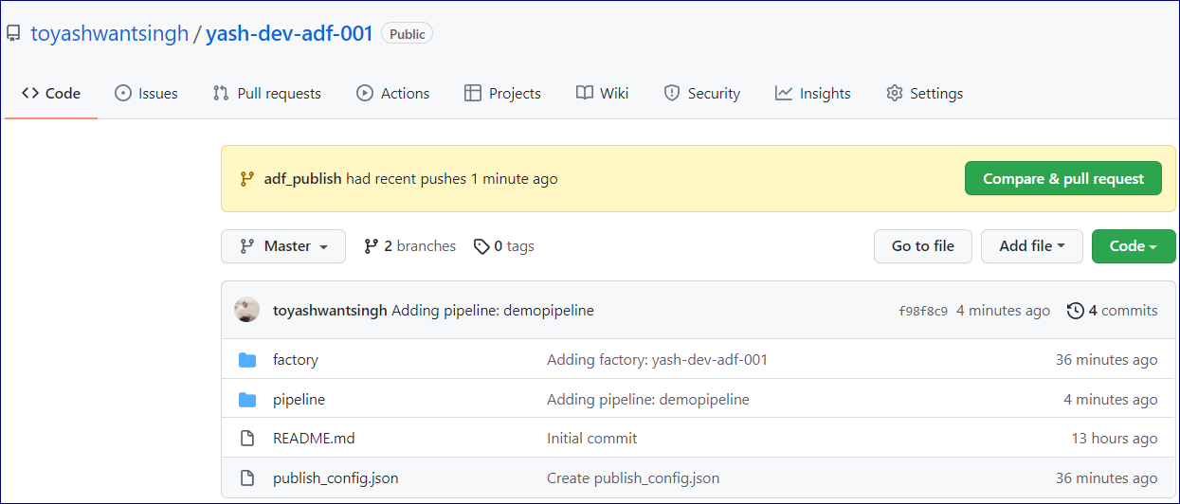
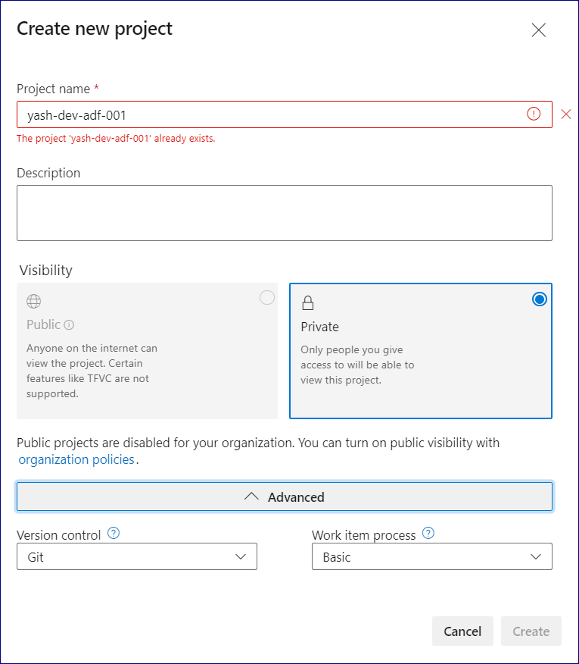
Once the ADF pipeline has been checked in, navigate back to the GitHub account repo to ensure that the pipeline has been committed.
Create a DevOps Project
1
After creating an Azure DevOps Account from the pre-requisites section, we'll need to creating a DevOps project along with a Build and Release pipeline.
Let's get started by creating a new project with the following details.
2
3
4

Slide 15
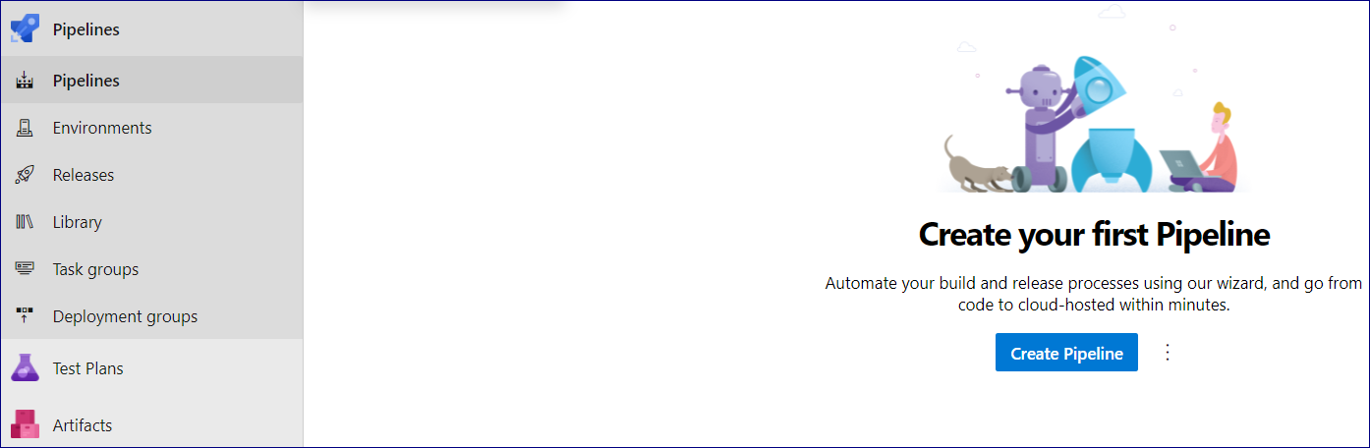
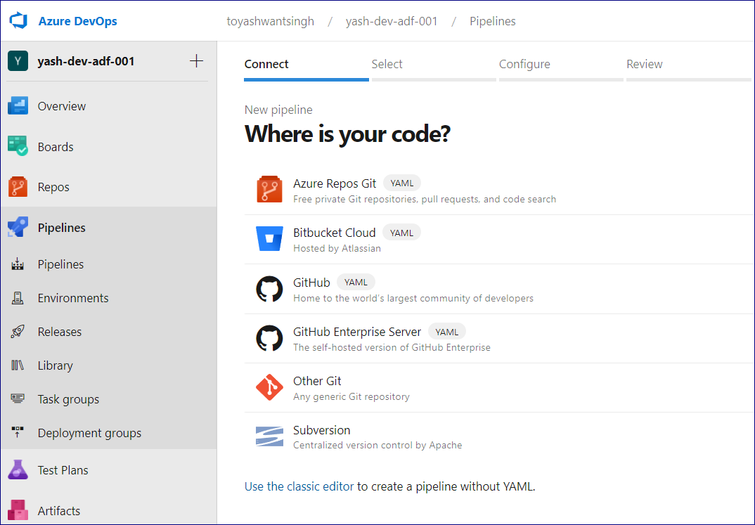
Create a DevOps Build Pipeline
1
2
Now it's time to create a DevOps Build Pipeline. This can be done by navigating to Pipelines tab of the project.
Select Pipelines from the list of options.
Create your first project pipeline by clicking Create Pipeline.
3
When prompted to select where your code is, click Use the classic editor toward the bottom.

Slide 16
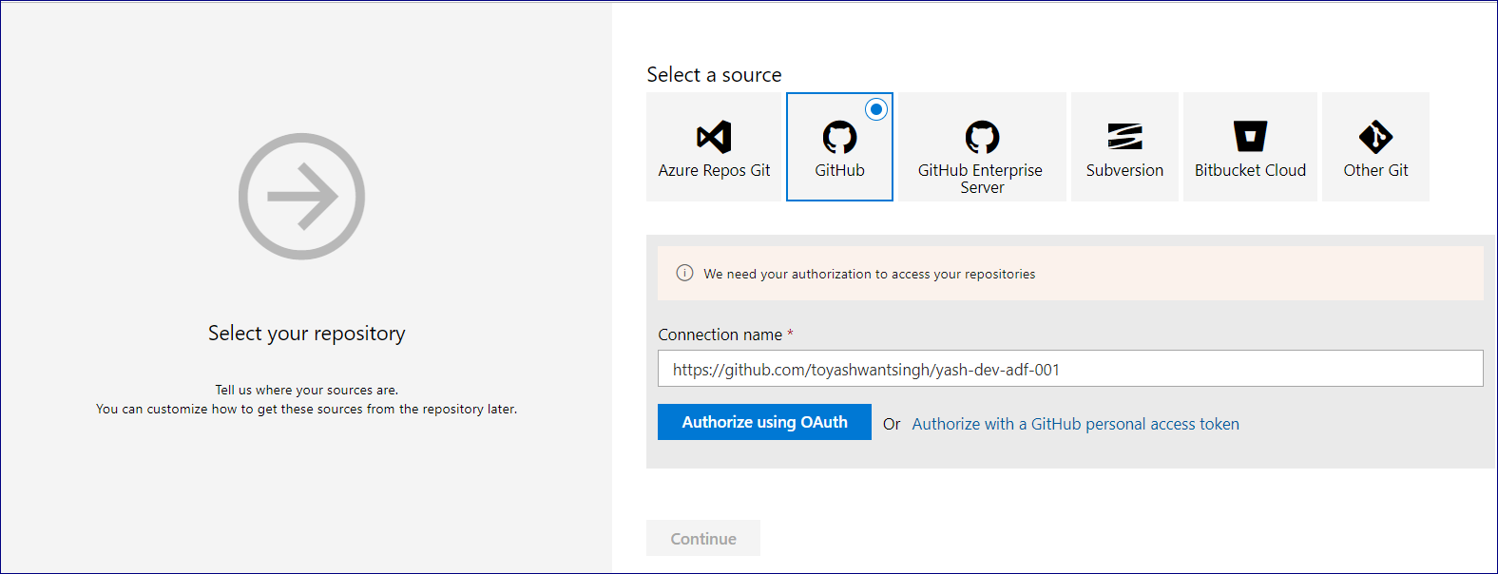
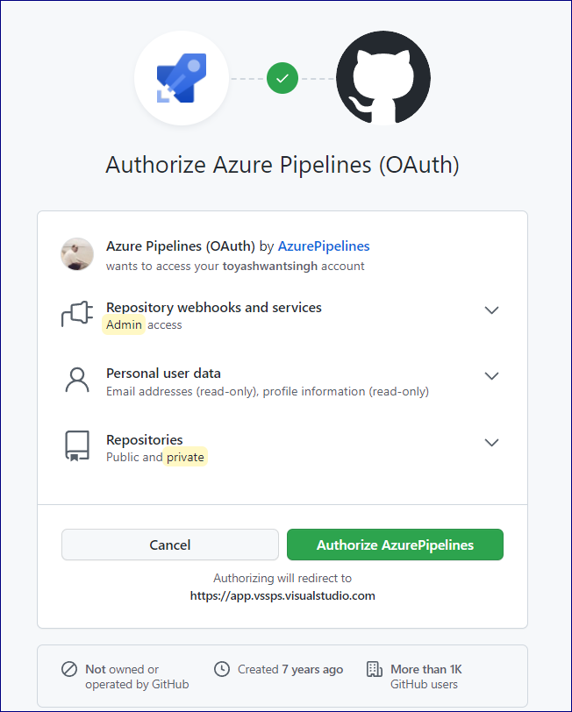
Select the following GitHub source, enter the connection name and click Authorize using OAuth.
1
2
3
Authorize Azure Pipelines using OAuth will display a UI for further verification. Once the authorization verification process is complete, click Authorize Azure Pipelines.

Slide 17
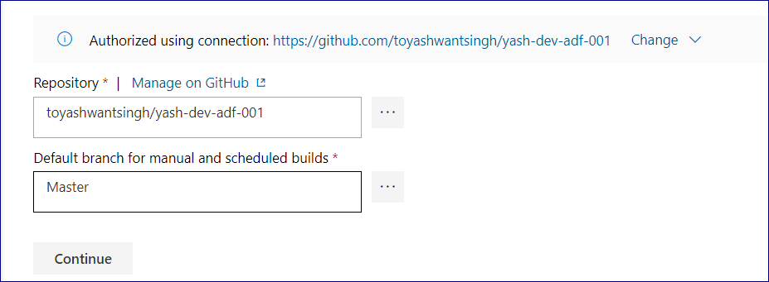
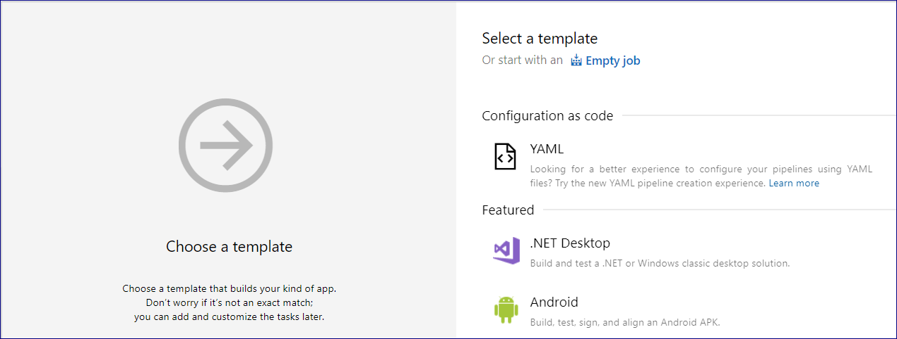
After the Azure Pipelines are authorized using OAuth, the authorized connections along with the repo and default branch will be listed as follows and can be changed by clicking the … icon.
Click Continue to proceed.
1
2
3
When prompted to choose a template, select Empty job.

Slide 18
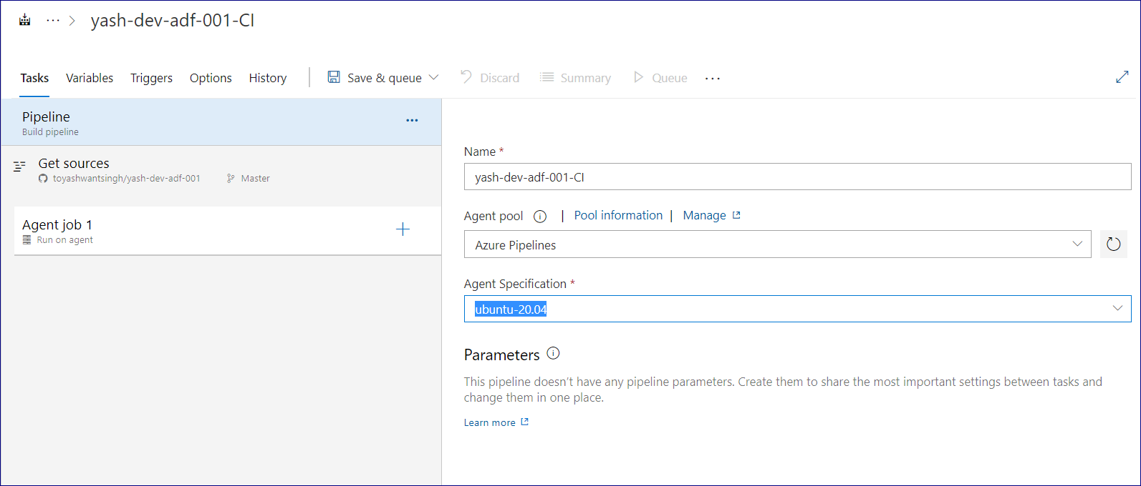
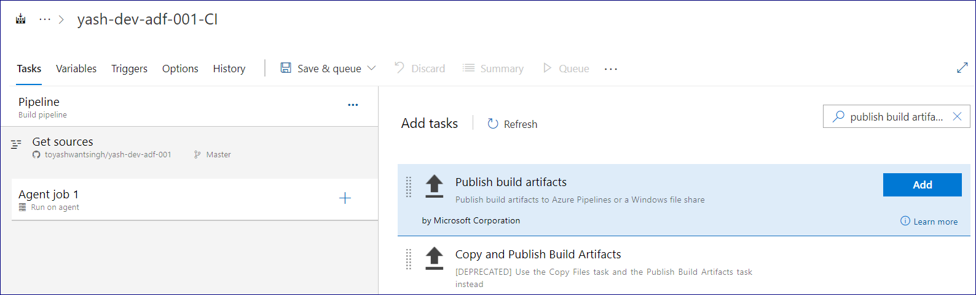
The Build Pipeline tab will contain the following details.
Configure and select the Name, Agent pool and Agent Specification.
1
2
3
4
Click the + icon by Agent job 1 to add a task to the job. and
Search for 'publish build artifacts' and add the task to the Build pipeline.
1
2

Slide 19
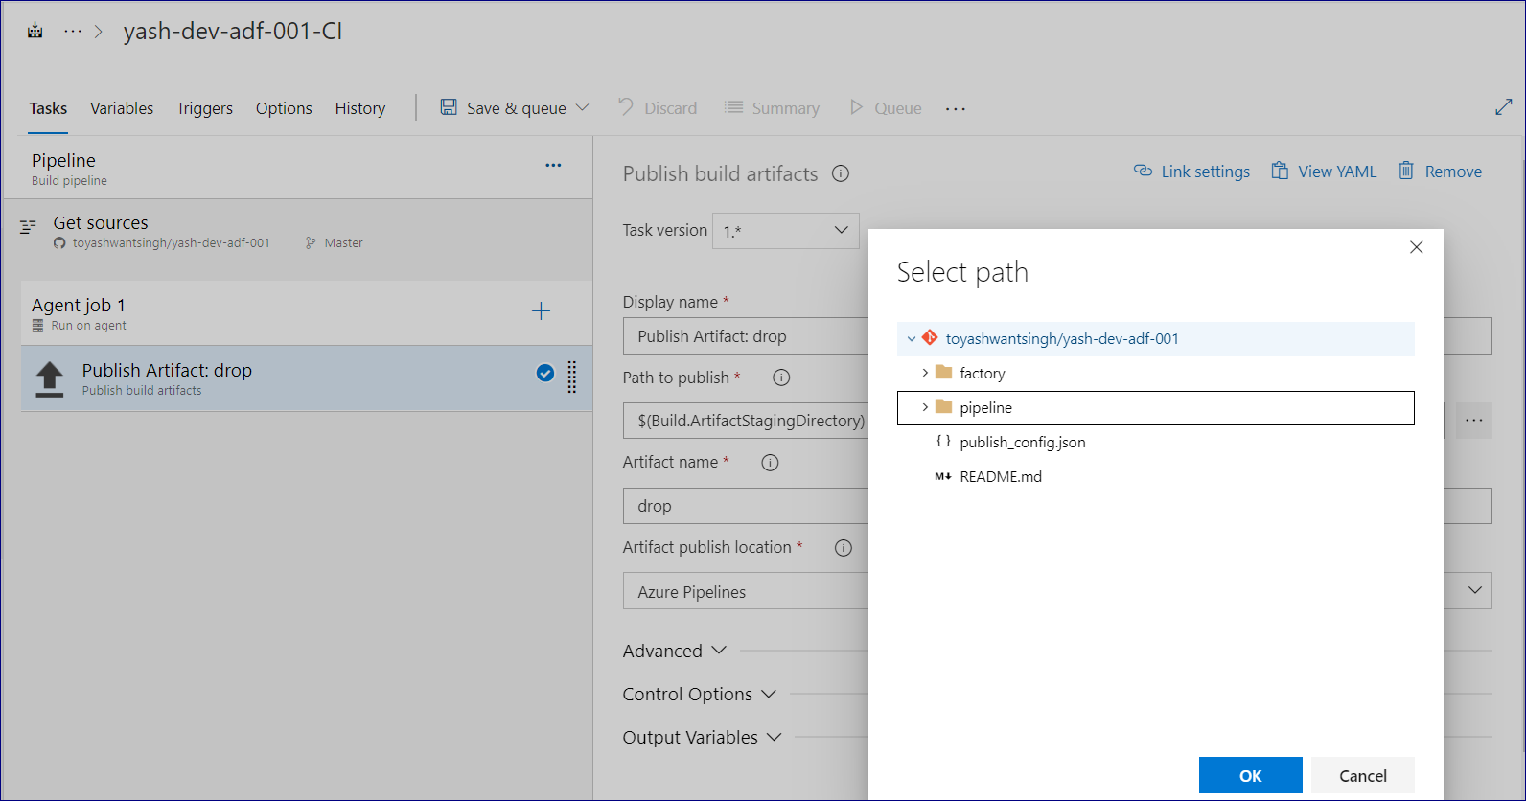
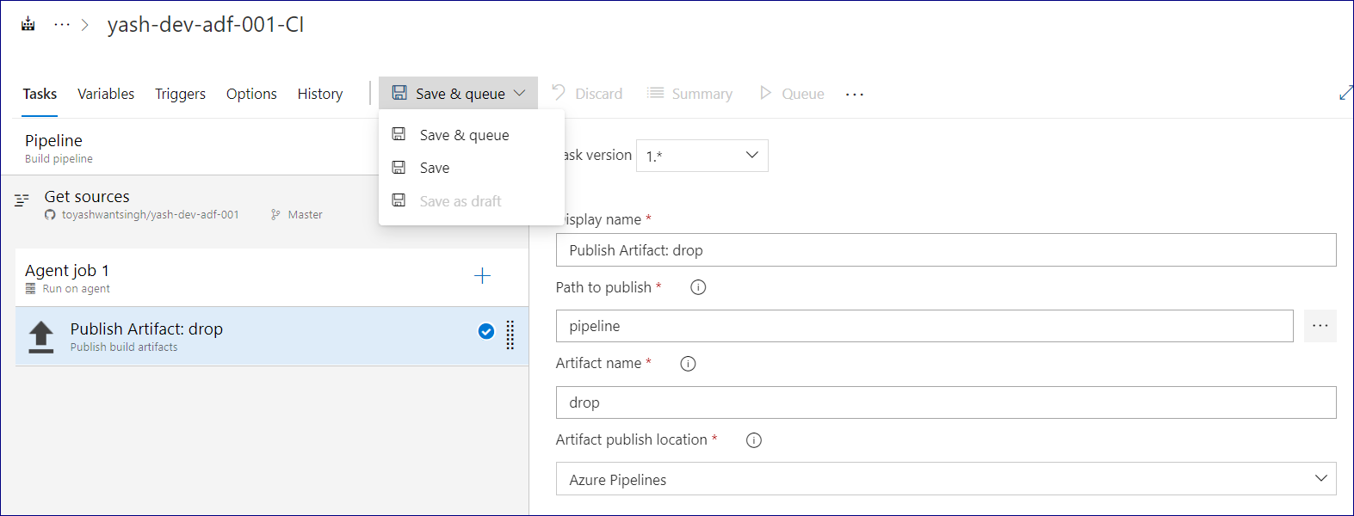
In the Publish build artifacts UI, enter the following details.
Also browse and select the path to publish.
Click OK after the path is selected.
Click Save & queue to prepare the pipeline to run.

Slide 20
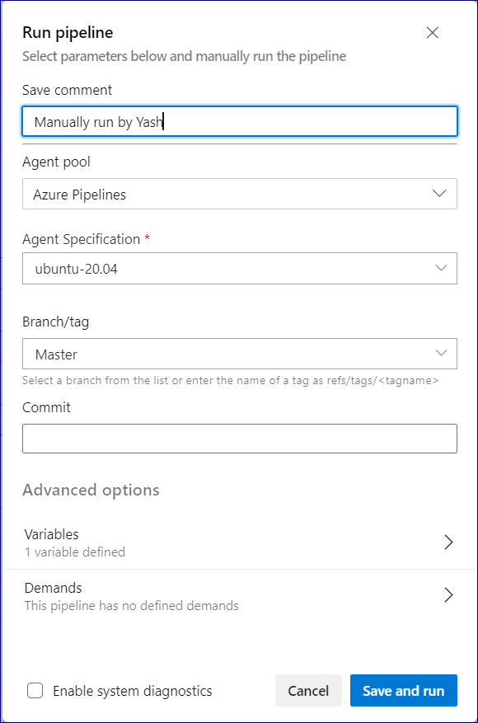
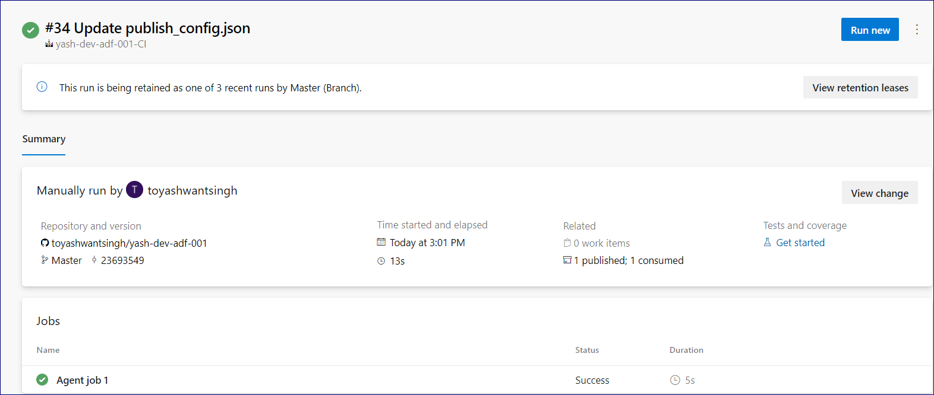
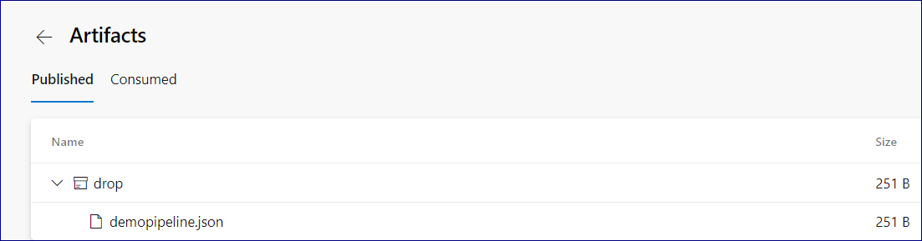
Finally, run the Build pipeline by clicking Save and run.
Note the pipeline run summary which indicates the repo, run date/times, and validation that the pipeline has been successfully published.
Notice that the demopipeline has been published in JSON format, which confirms that the build pipeline has successfully been published and is ready for release.
Click the following published icon for more detail.
Notice that the demopipeline has been published in JSON format, which confirms that the build pipeline has successfully been published and is ready for release.

Slide 21
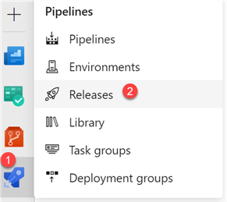
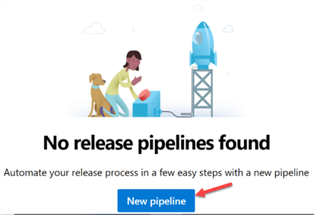
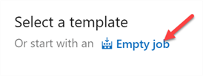
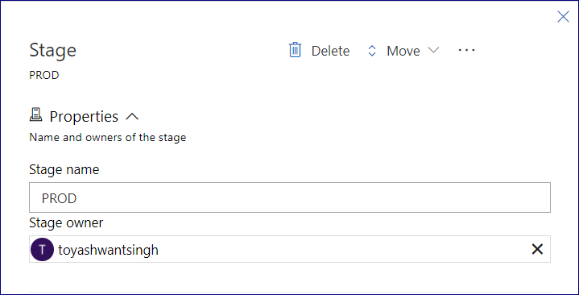
Create a DevOps Release Pipeline
Now that the Build Pipeline has been created and published, we are ready to create the Release pipeline next.
To do this, click the pipelines icon, and select Releases.
Azure DevOps will let you know that there a no release pipelines found.
Go ahead and click New Pipeline.
When prompted to select a template, click Empty job.
Enter a Stage name and verify the Stage Owner. For my scenario, I will select PROD.

Slide 22
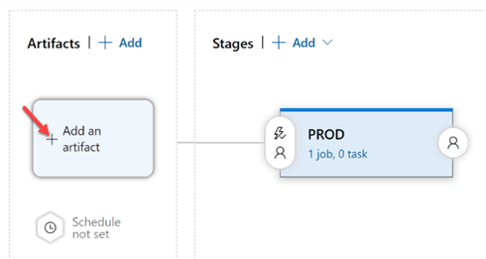
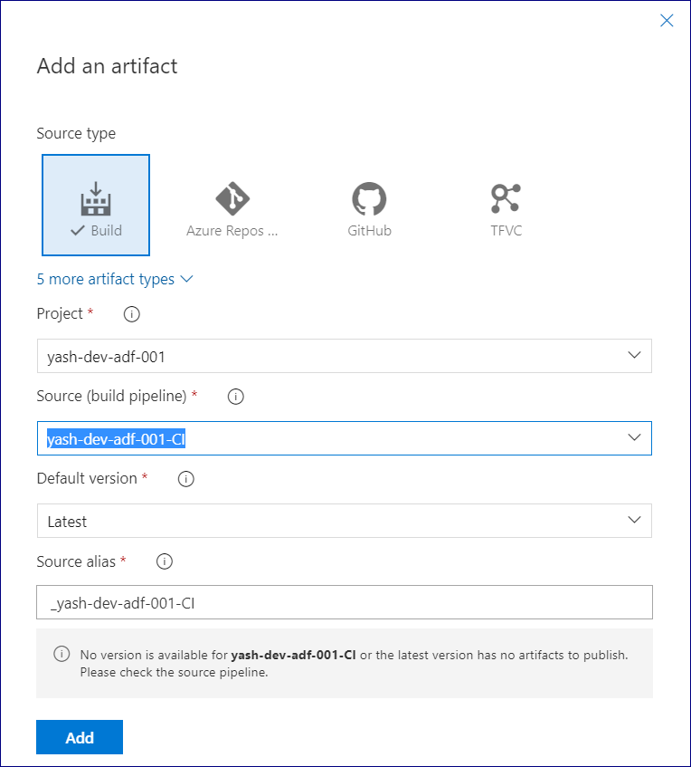
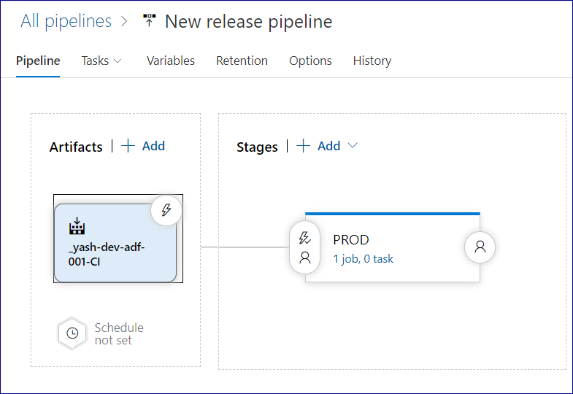
Next, let's go ahead and Add an artifact.
Ensure that the source time is Build and that the correct Source (build pipeline) is selected.
Click Add to add the selected artifact.
In the Stages section where we have the PROD stage which was created earlier, notice that there is 1 job and no tasks associated with it yet.
Click to view the stage tasks.

Slide 23
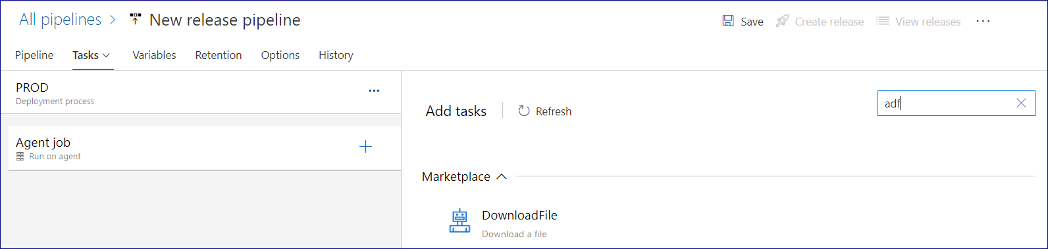
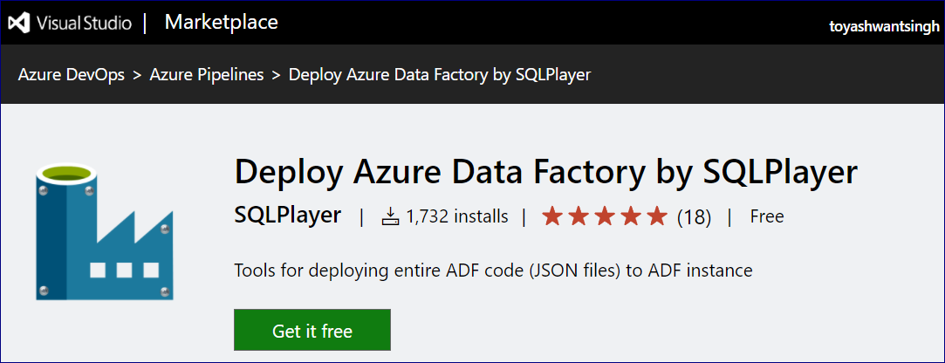
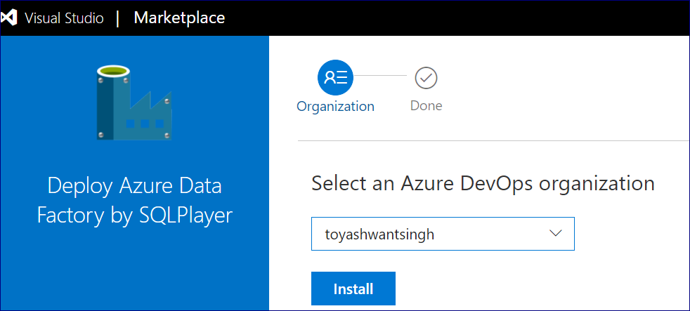
Search for adf and click Get it free to download the Deploy Azure Data Factory task.
2
1
3
You'll be re-directed to the Visual Studio marketplace.
Once again, click Get it free to download the task.
For more information on this Deploy Azure Data Factory task, see this PowerShell module which it is based on, azure.datafactory.tools.
Select the Azure DevOps organization and click Install.

Slide 24
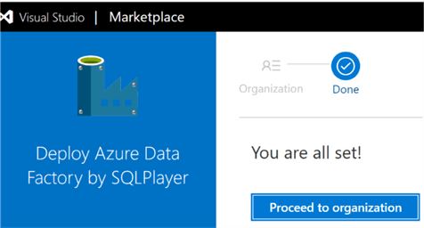
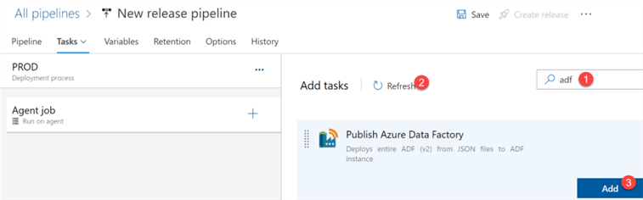
When the download succeeds, navigate back to the DevOps Release pipeline configuration process.
Add the newly downloaded Publish Azure Data Factory task to the release pipeline.
The Publish Azure Data Factory task will contain the following details that will need to be selected and configured.
For a list of subscription connection options, select Manage.
Click the … icon to select the Azure Data Factory Path.

Slide 25
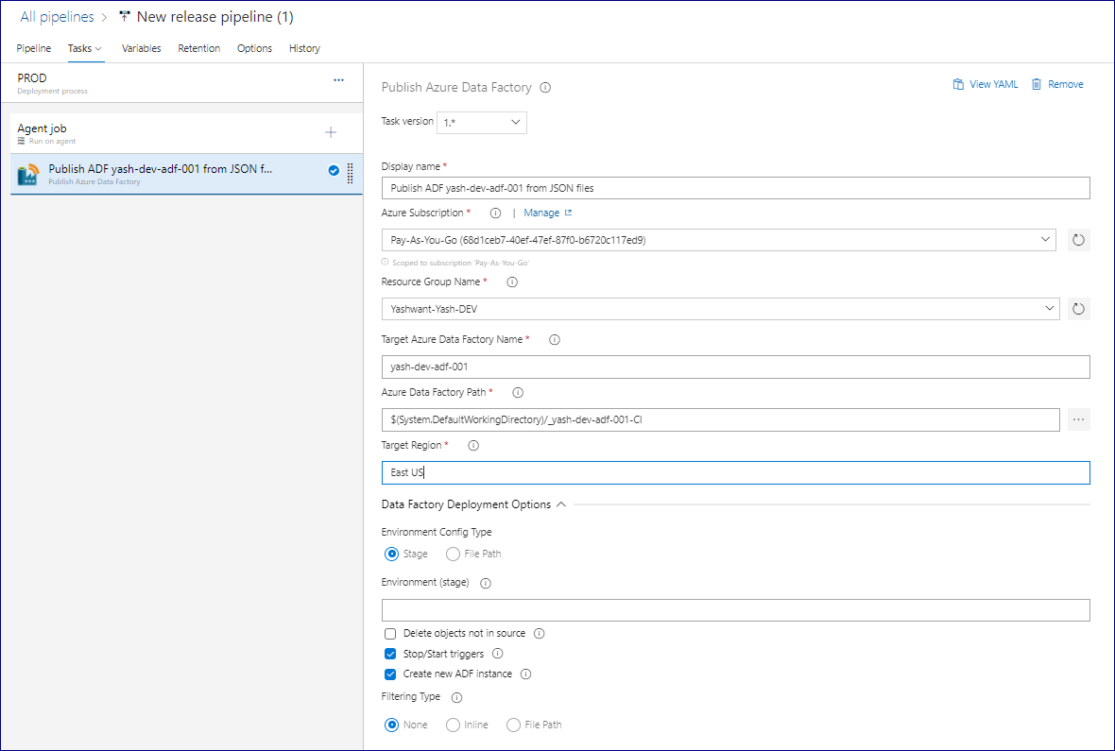
After the file or folder is selected, click OK.
Also ensure that the release pipeline is named appropriately, click Save.
1
2
Click Create release.

Slide 26
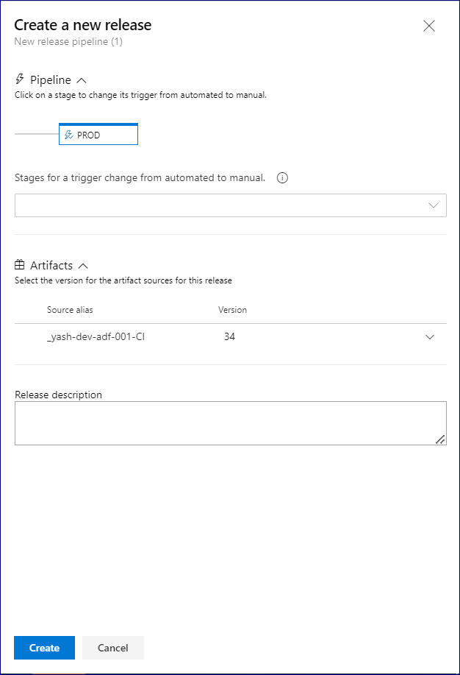
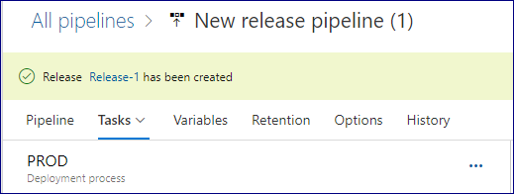
Finally, click Create one last time.
Once the release has been created, click the Release-1 link.

Slide 27
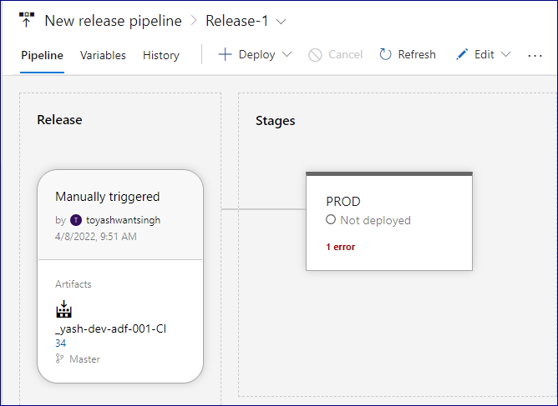
View the adf release pipeline details and note that the PROD Stage has been successfully published.
Throwing error because of Deployment permission still in pending state
Verify the New Data Factory Environment
After navigating back to the Portal, select the resource group containing the original dev Data Factory.
Notice that there is now an additional Data Factory containing the prod instance.
Will update the screenshot once Release pipeline approved

